Slide 1


History
Vikings and Anglo-Saxons
Year One
History | LKS2 | Vikings and Anglo-Saxons | Viking Raiders and Invaders | Lesson 1

Slide 2
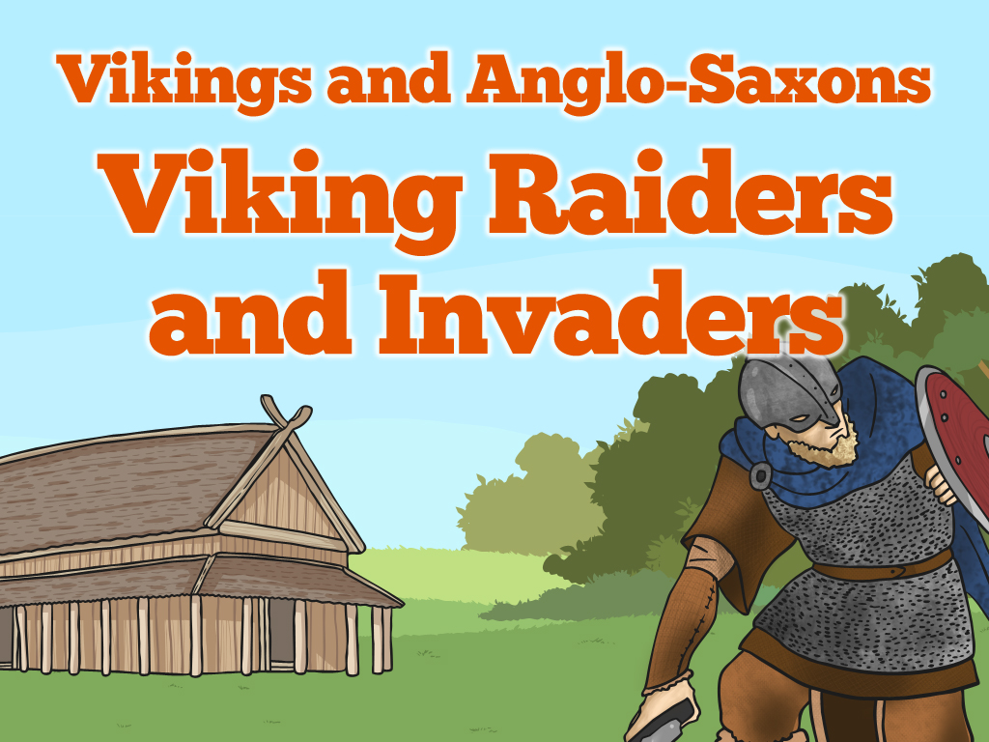


Slide 3
Aim
I can explain when and where the Vikings came from and say why they raided Britain.
Success Criteria
I can order events from the time of the Vikings.
I can create a poster containing details about who the Vikings were and what they did.
I can act in role to ask or answer questions.

Slide 4

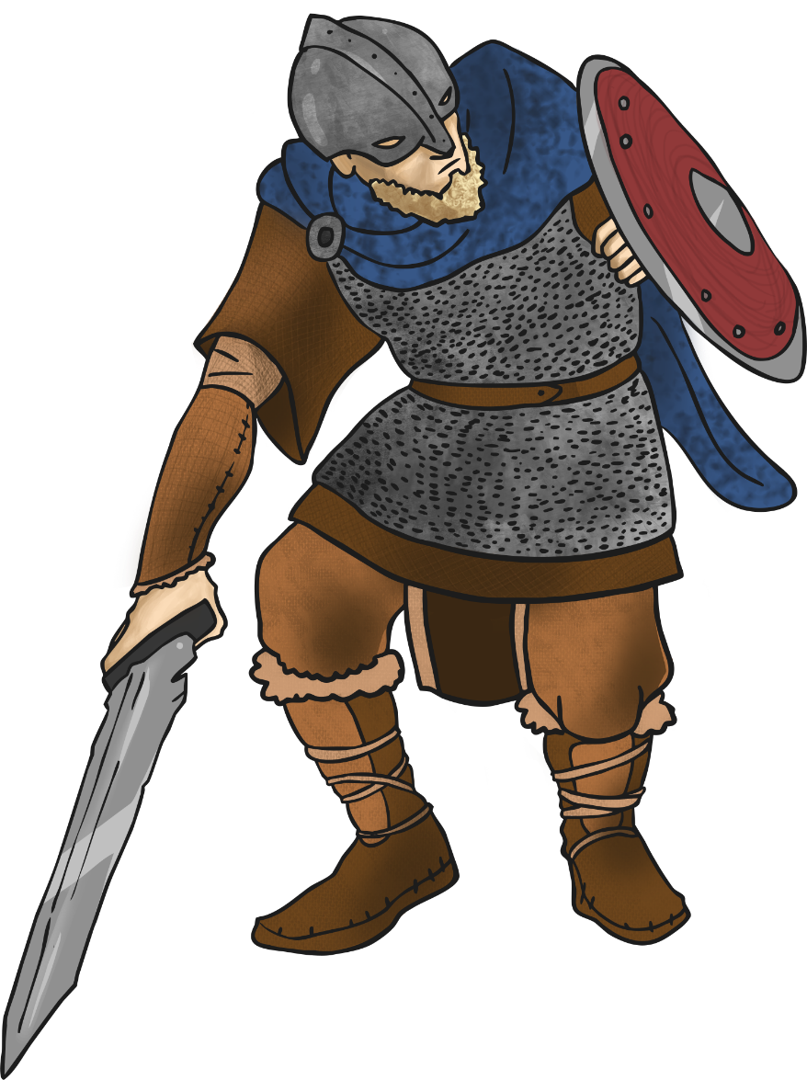
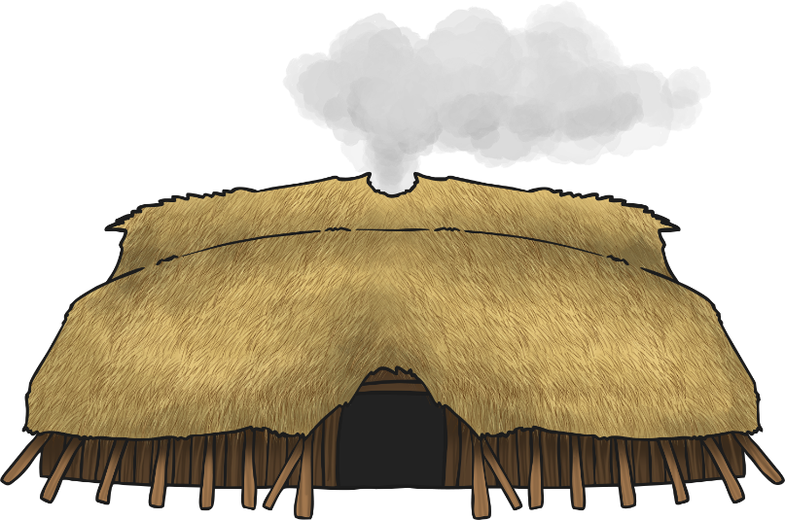

The Vikings
Questions
Discuss these questions with the other children in your group and then be ready to feedback to the rest of the class.
Who were the Vikings?
Where did they come from?
What did they do?
When did they come to Britain and why?
What else do we know about them?

Slide 5
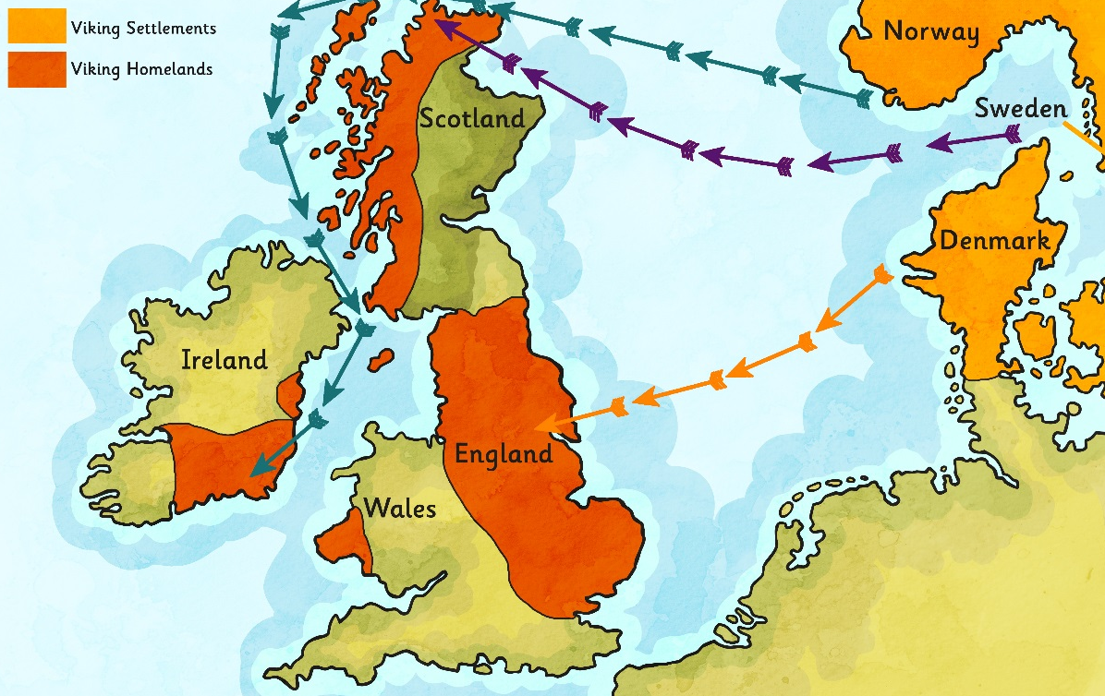
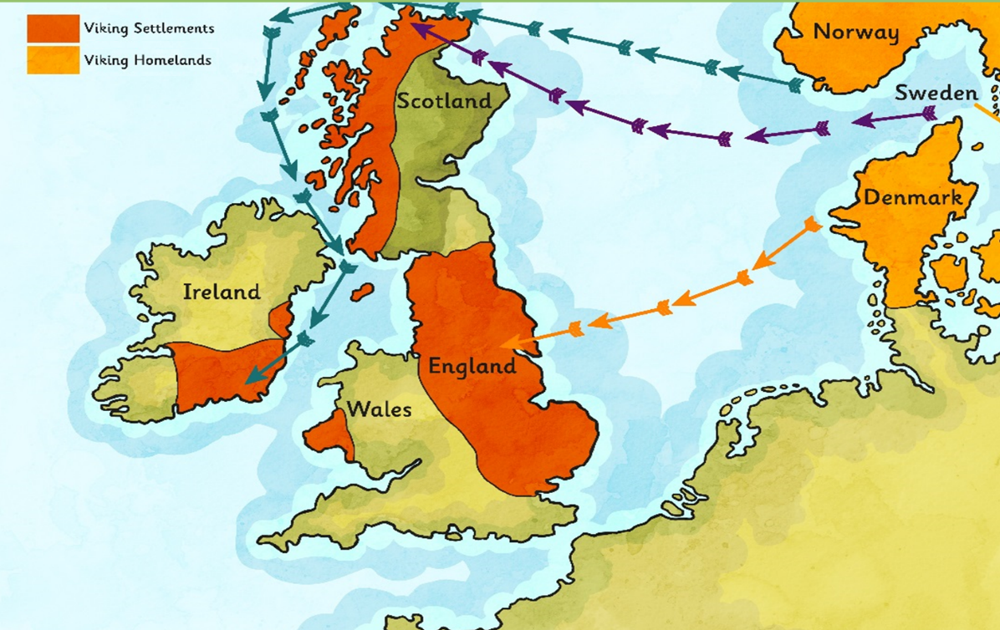
The Vikings Arrive
The Vikings came from the area of the modern Scandinavian countries (Denmark, Norway and Sweden).
They set out in boats called longships to ‘go Viking’ (which means to go travelling around looking for resources and land to claim as their own).
The Vikings first arrived in Britain around AD 787 and in AD 793 they raided and pillaged the monastery at Lindisfarne in Northumbria.
Glossary
Longship – a long, wooden, narrow boat used by the Vikings.
Pillage – to steal goods using violent tactics.
Raid – to suddenly attack a place.

Slide 6
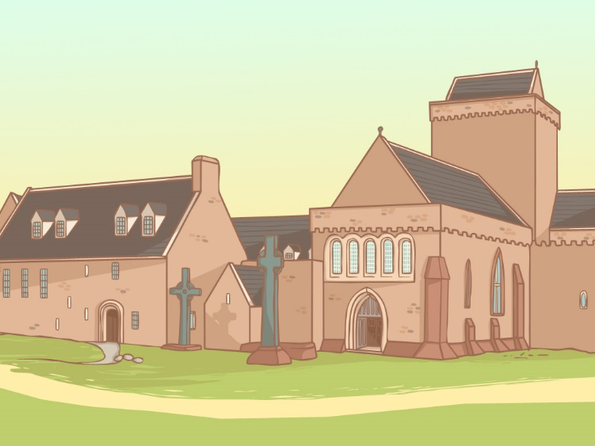
Raiders
The Vikings came to Britain looking for lucrative new items to steal and trade. In addition they wanted land that they could take and claim as their own.
They particularly liked to raid monasteries, like the one at Lindisfarne. The monasteries were not very well protected and contained valuable goods like gold and jewels, imported foods and other useful materials.
The Vikings also stole manuscripts and bibles. These were sold back to the religious leaders who could not bear to see them lost or damaged.

Slide 7
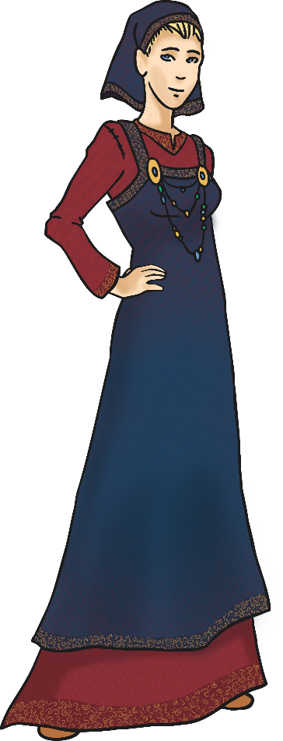
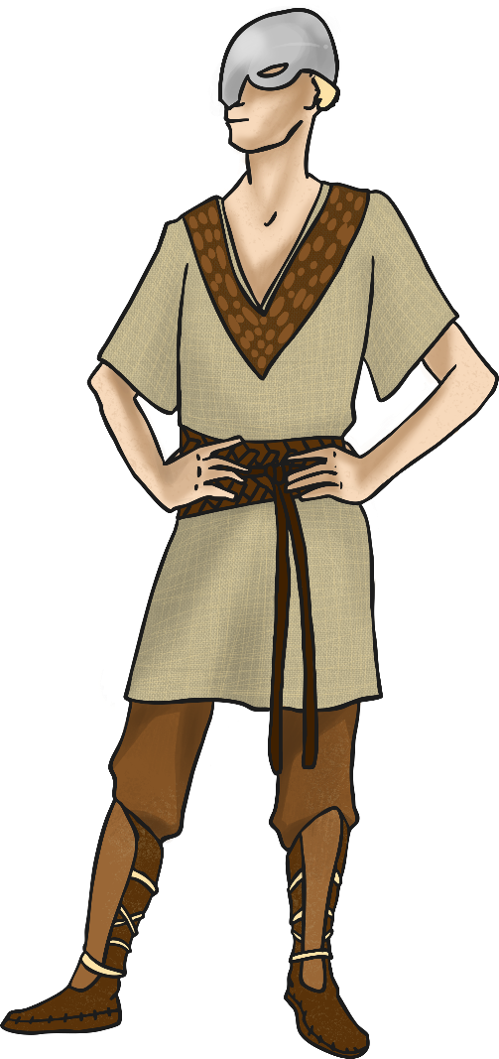
Invaders and Settlers
The Vikings went on to invade Scotland and in time they began to settle and stay there.
They were able to build up an army and in AD 866 they captured the city of York.
The Anglo-Saxon King Alfred the Great, who became King of Wessex in AD 871, managed to force the Vikings out of the South of England but this was short-lived.
By AD 878 the Vikings had settled permanently in England, overran Wessex and forced King Alfred into hiding. The Vikings were here to stay!

Slide 8
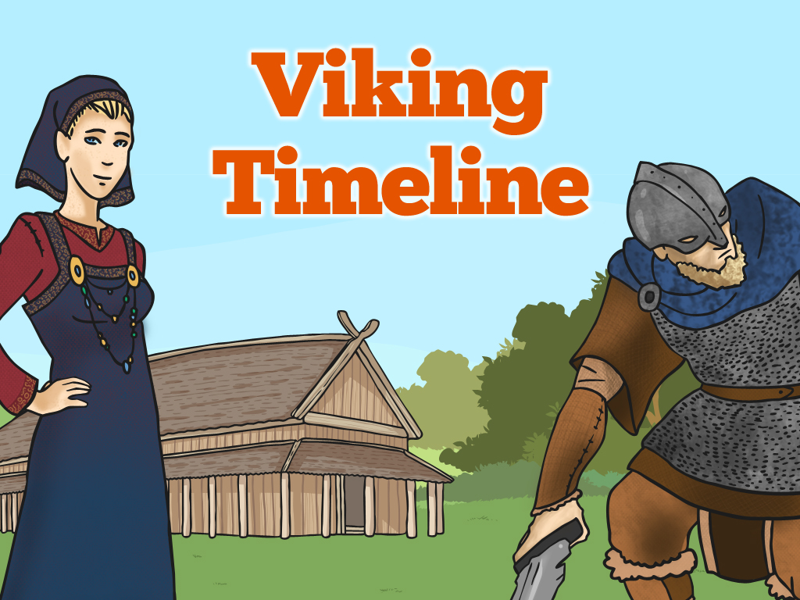

Slide 9
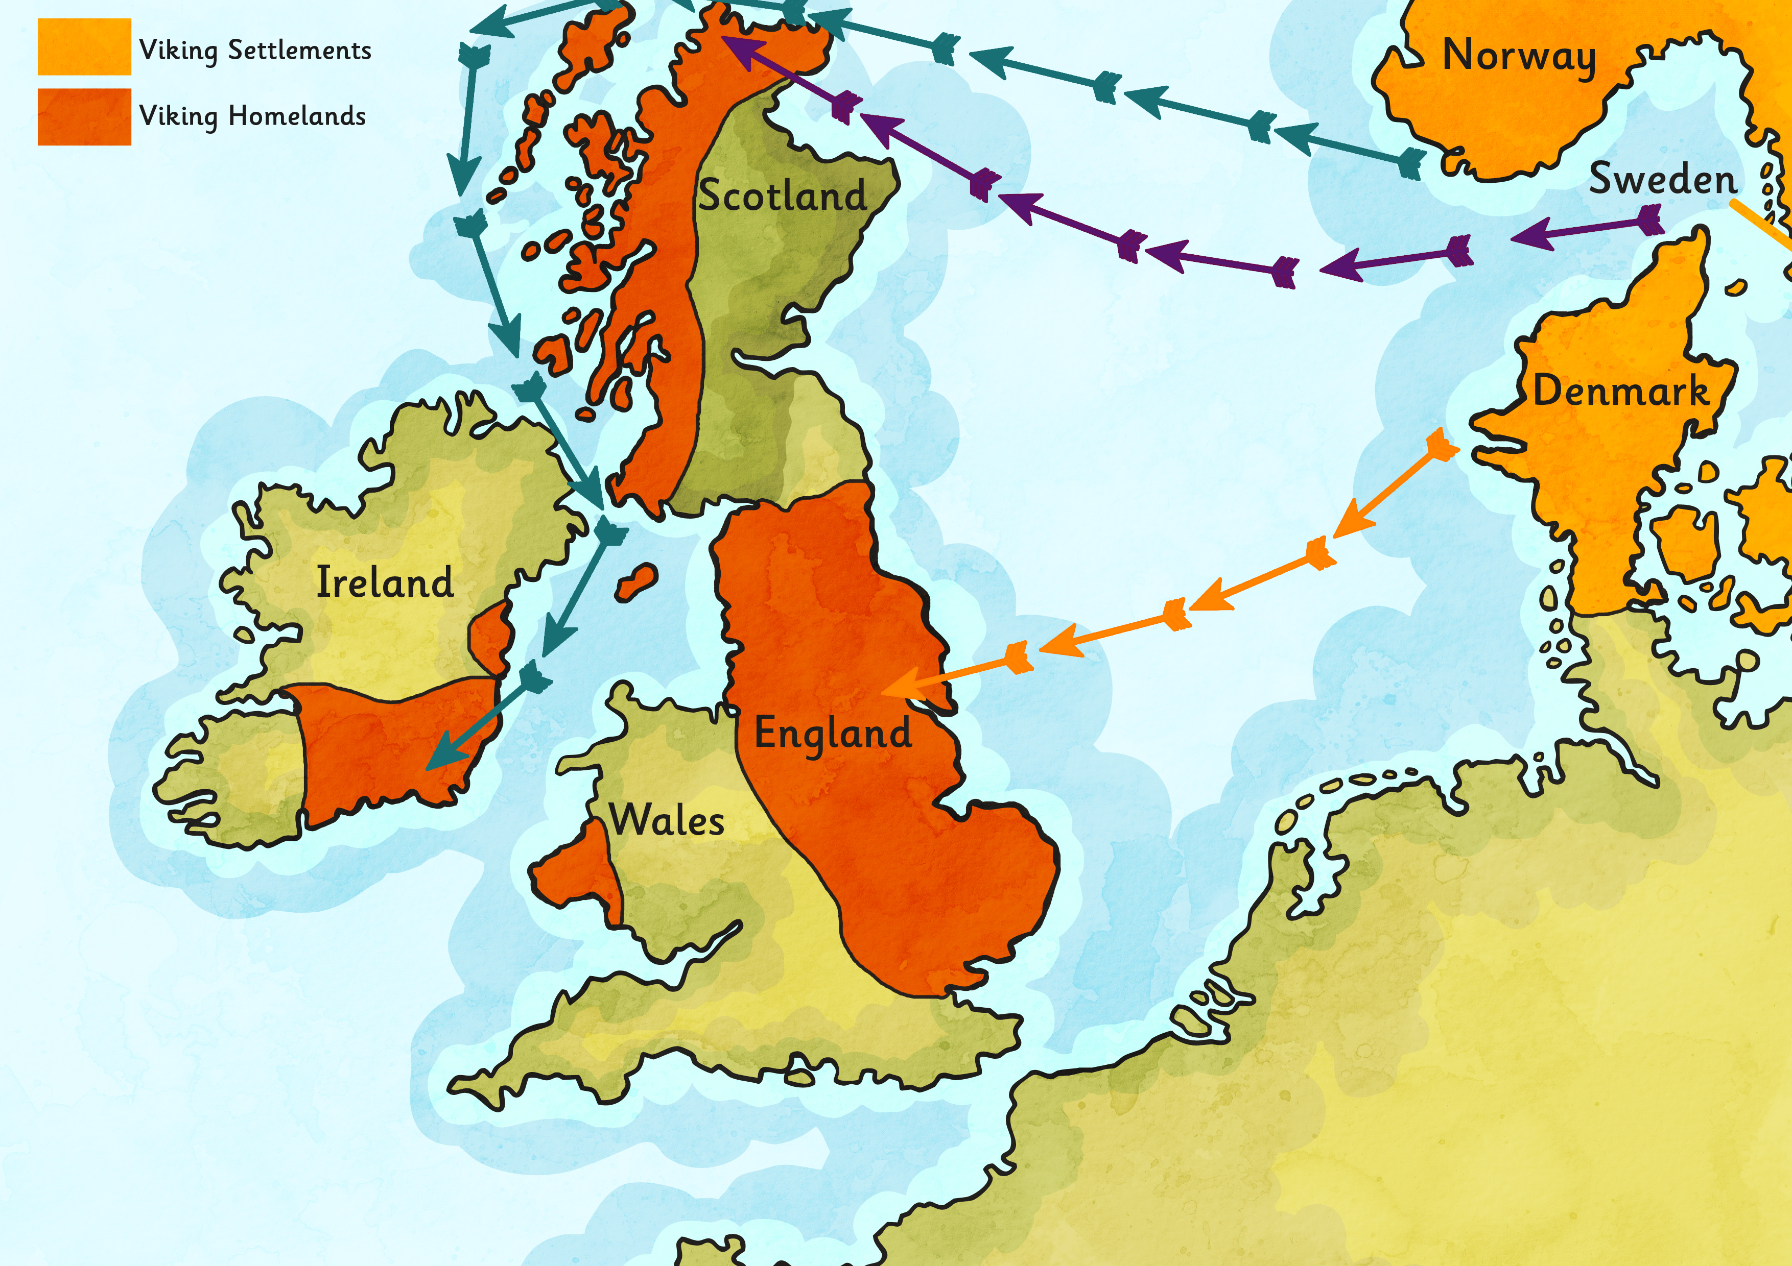
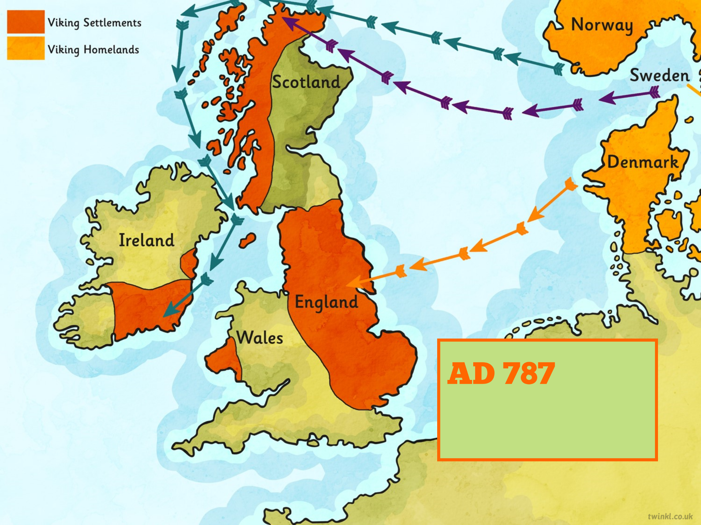
AD 787
First Viking raid in England occurred.

Slide 10
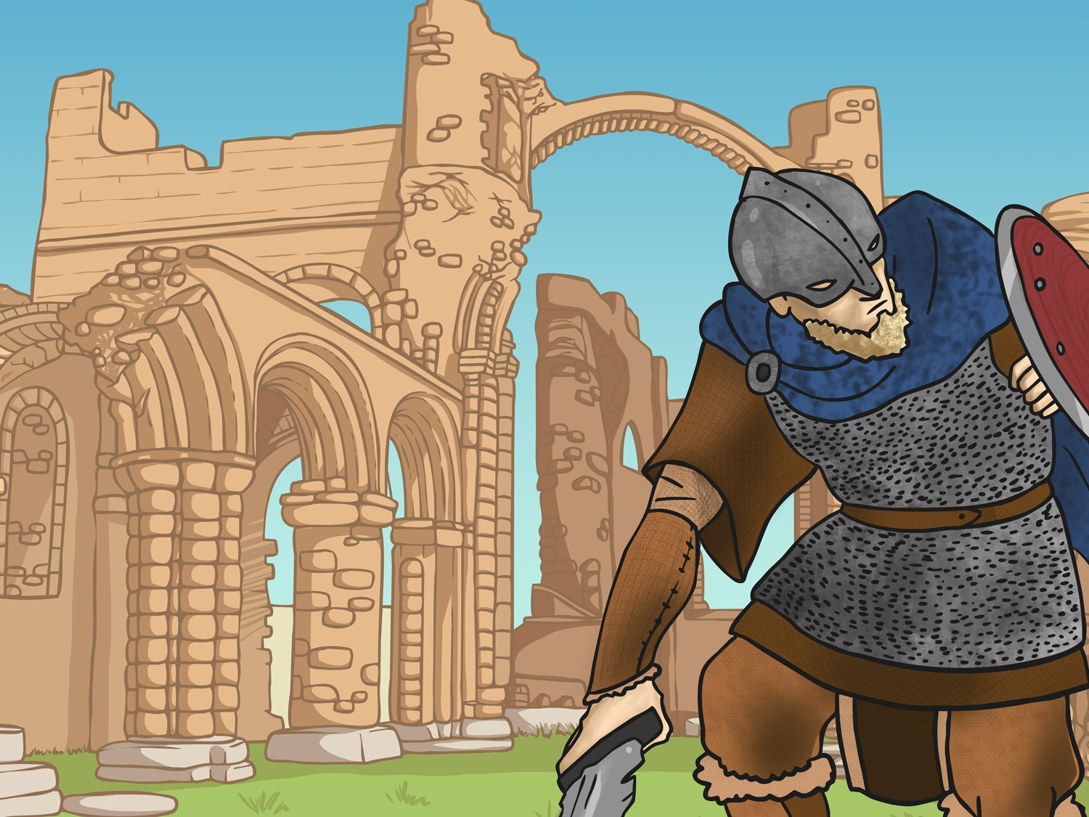
AD 793
The Vikings attack from Norway. They attack the Monastery of Lindisfarne in Northumbria. The following year they attack northern Britain, in what we now call Scotland.

Slide 11
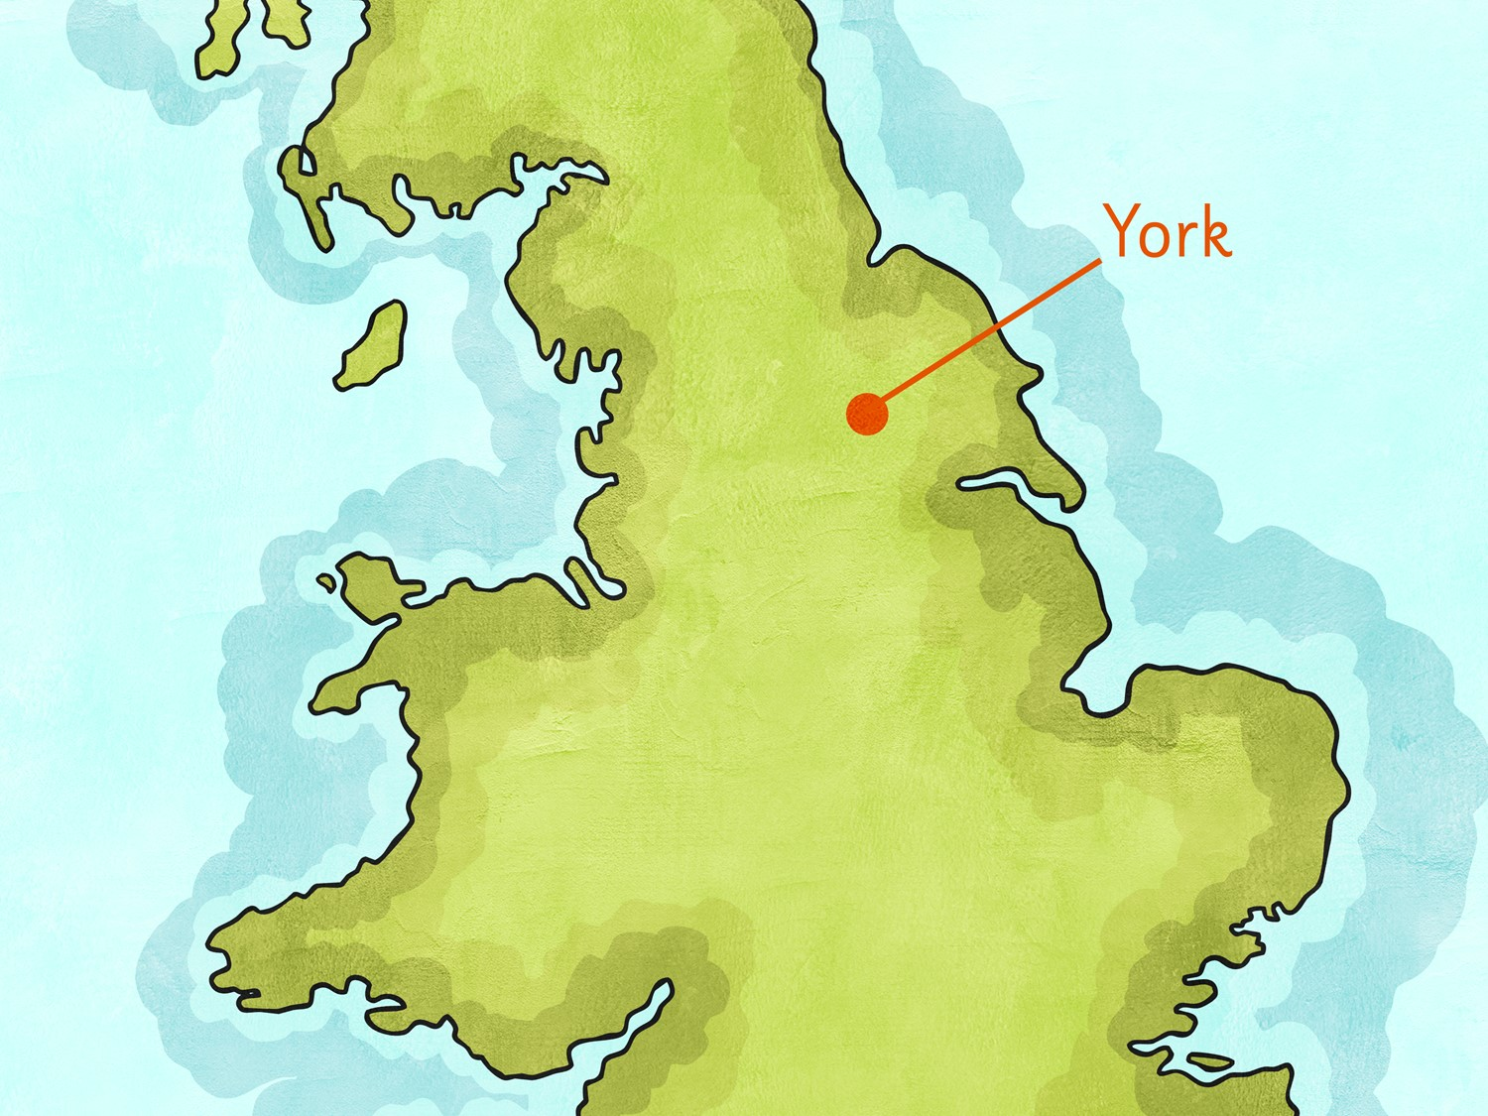

AD 866
The Vikings capture the city of York.

Slide 12
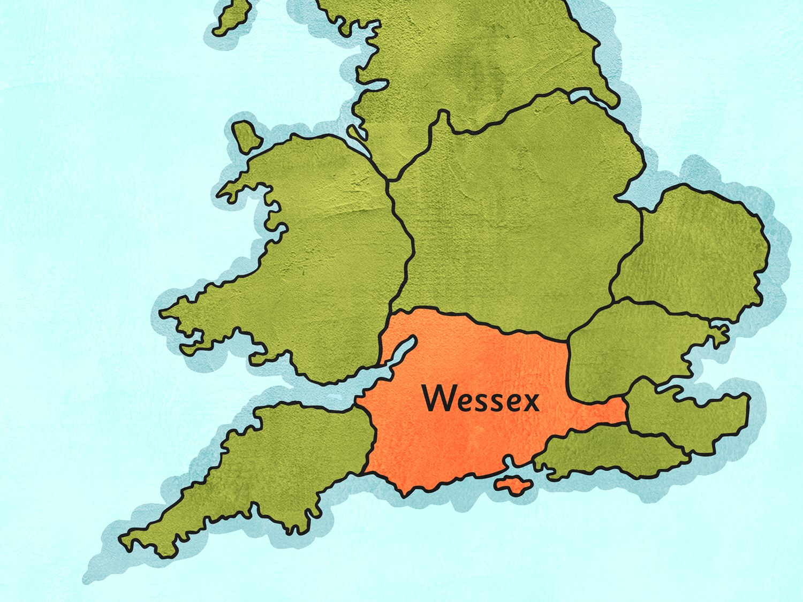

AD 870
Wessex is the last Anglo-Saxon kingdom.

Slide 13
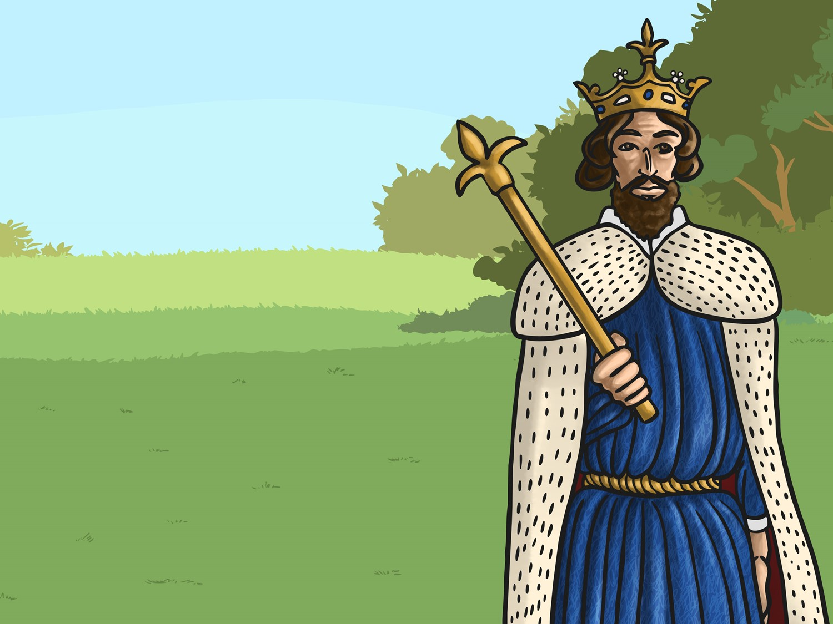
AD 871
Alfred the Great becomes King of Wessex. He drives the invading Vikings from the south but they stay in the north and the east.

Slide 14
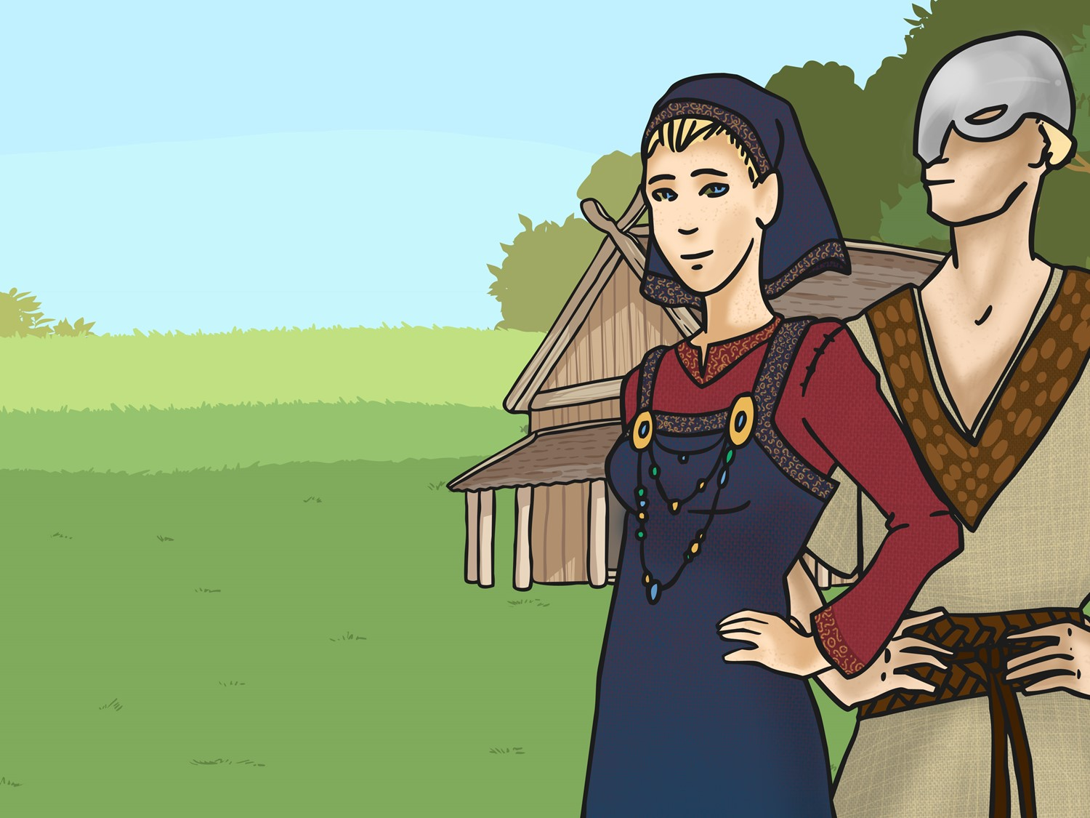
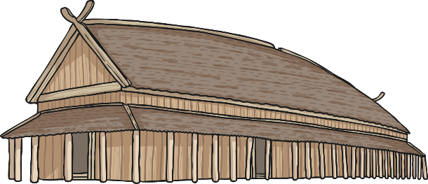
AD 878
By this time, the Vikings had settled permanently in England, overran Wessex and forced King Alfred into hiding.

Slide 15
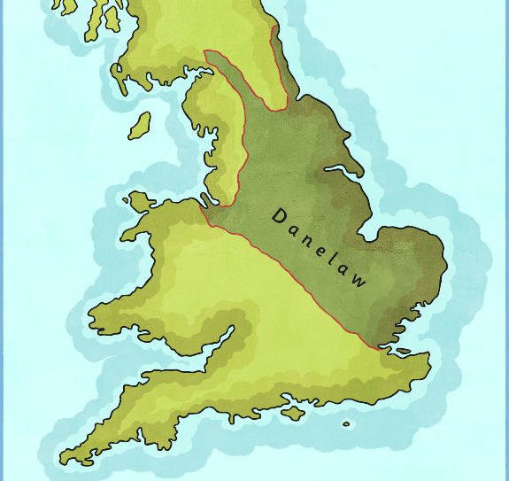
AD 886
King Alfred agrees to a treaty with the Vikings. Alfred keeps the west and the Vikings are given the east which is later known as ‘Danelaw’.

Slide 16
AD 900
The Vikings establish rule over northern Scotland

Slide 17
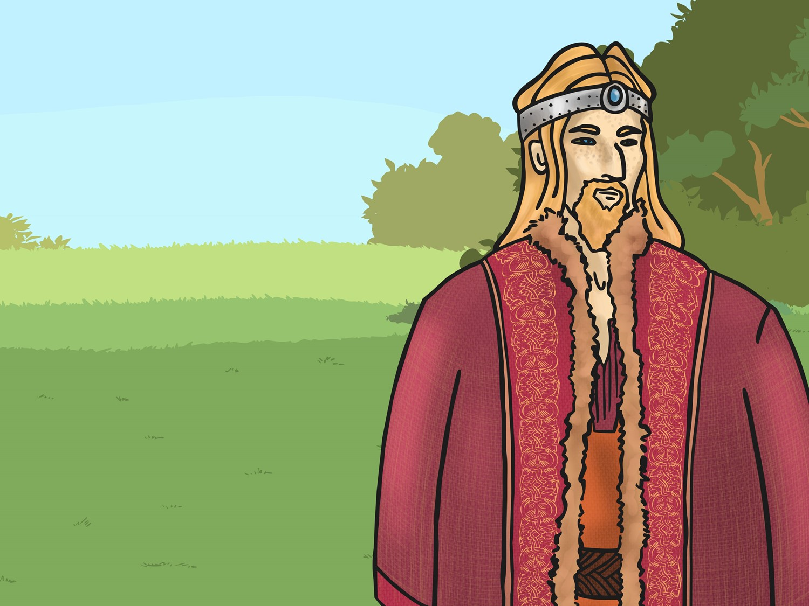
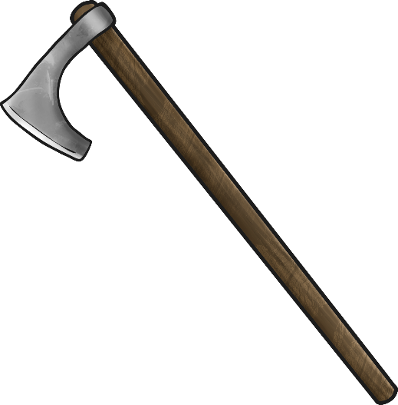
AD 954
The last Viking King of Jorvick (York), Eric Bloodaxe, is forced out of York.

Slide 18
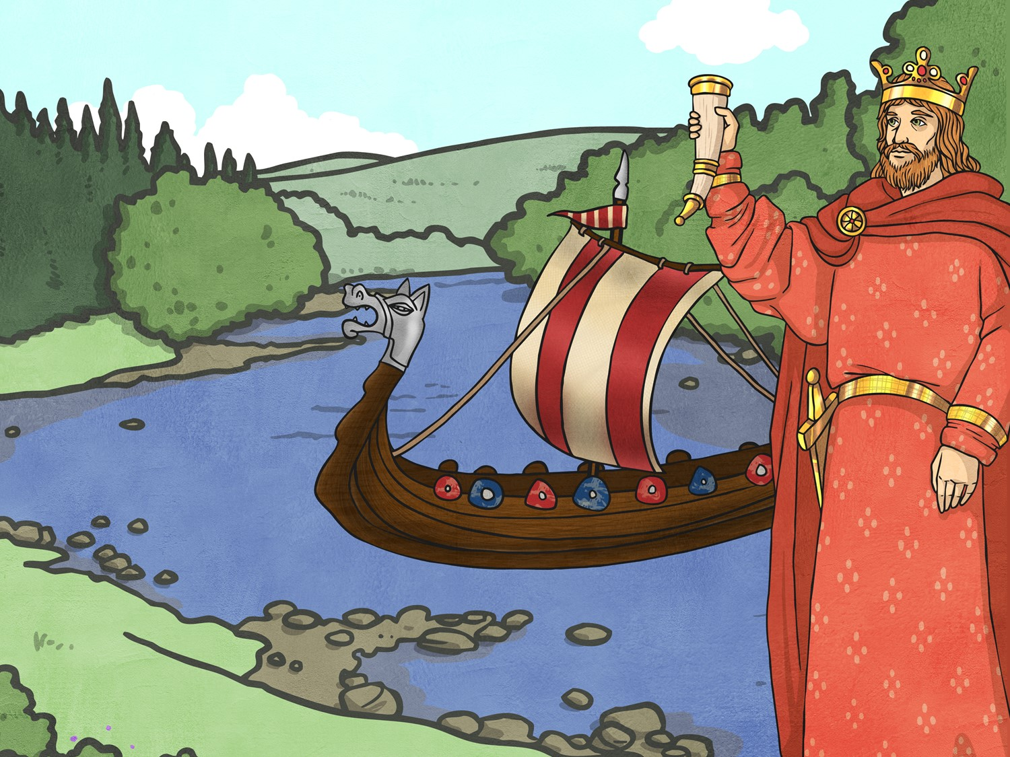
AD 1013
King Sven of Denmark and his son Cnut sail up the rivers Humber and Trent to claim the throne in Danelaw and Ethelred, the Saxon King, flees abroad.

Slide 19
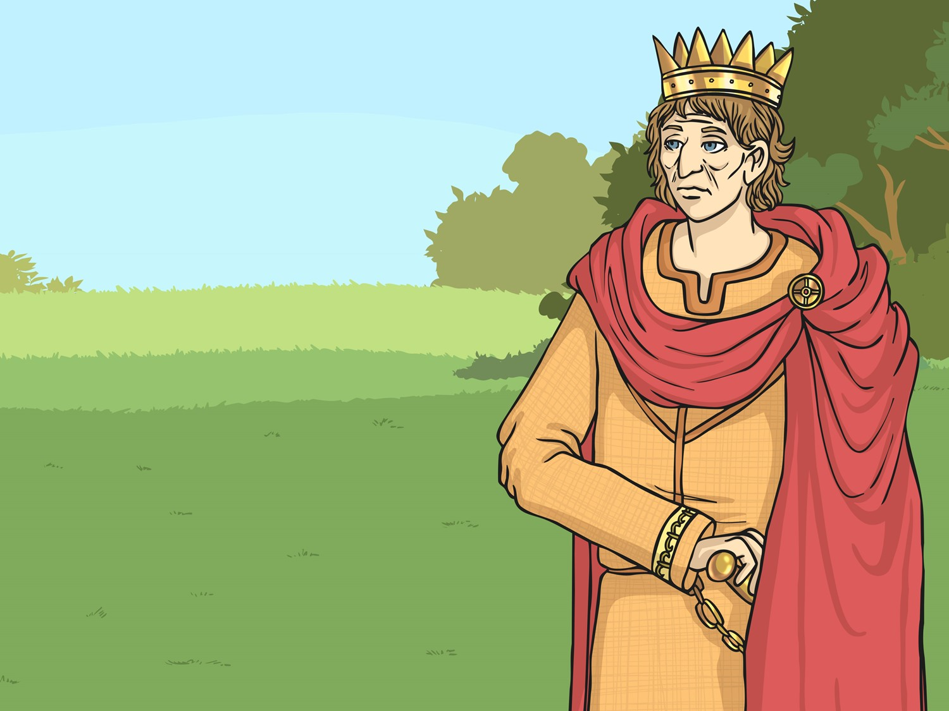
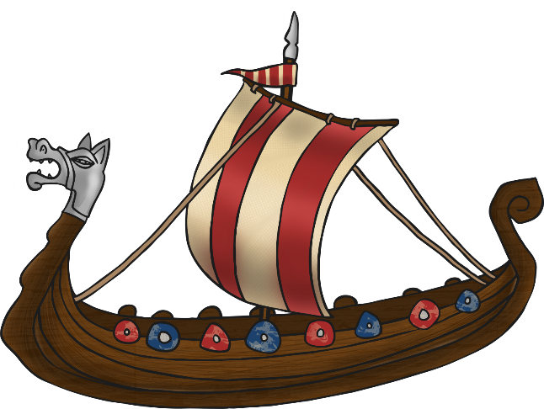
AD 1014
King Sven dies and Ethelred returns to rule England again.

Slide 20
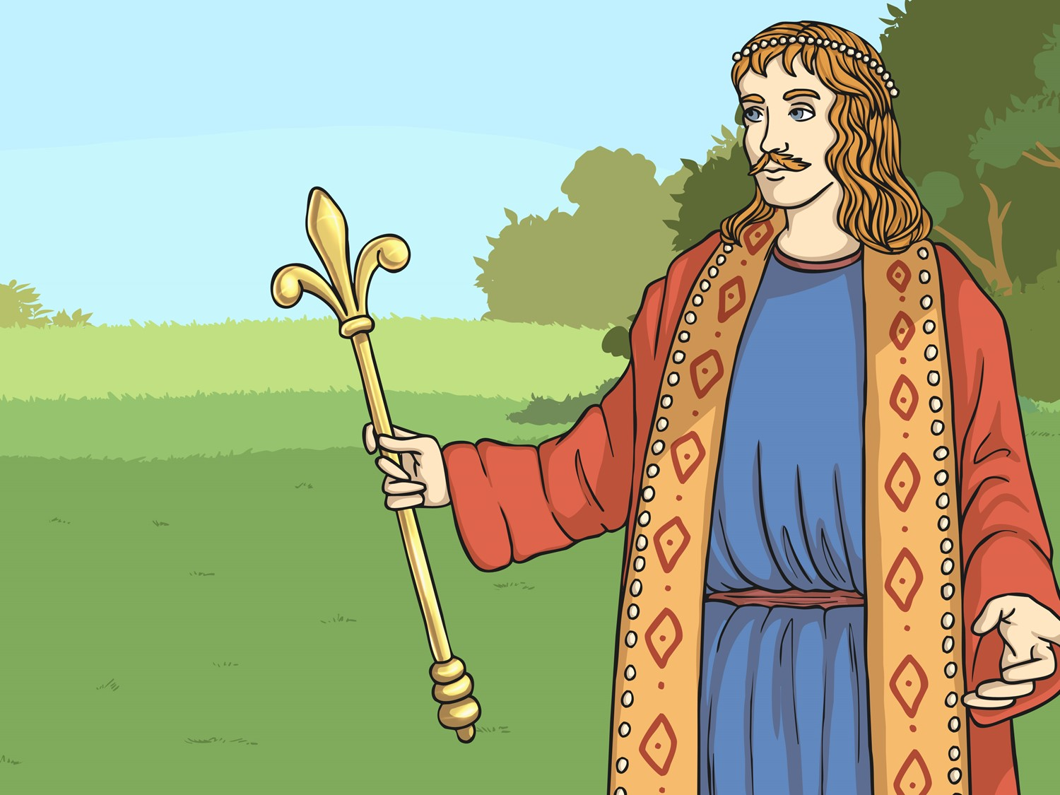
AD 1016
King Ethelred dies. His son, Edmund Ironside, becomes king for a few months until he also dies.
Cnut becomes King of the Danes and King of England.

Slide 21
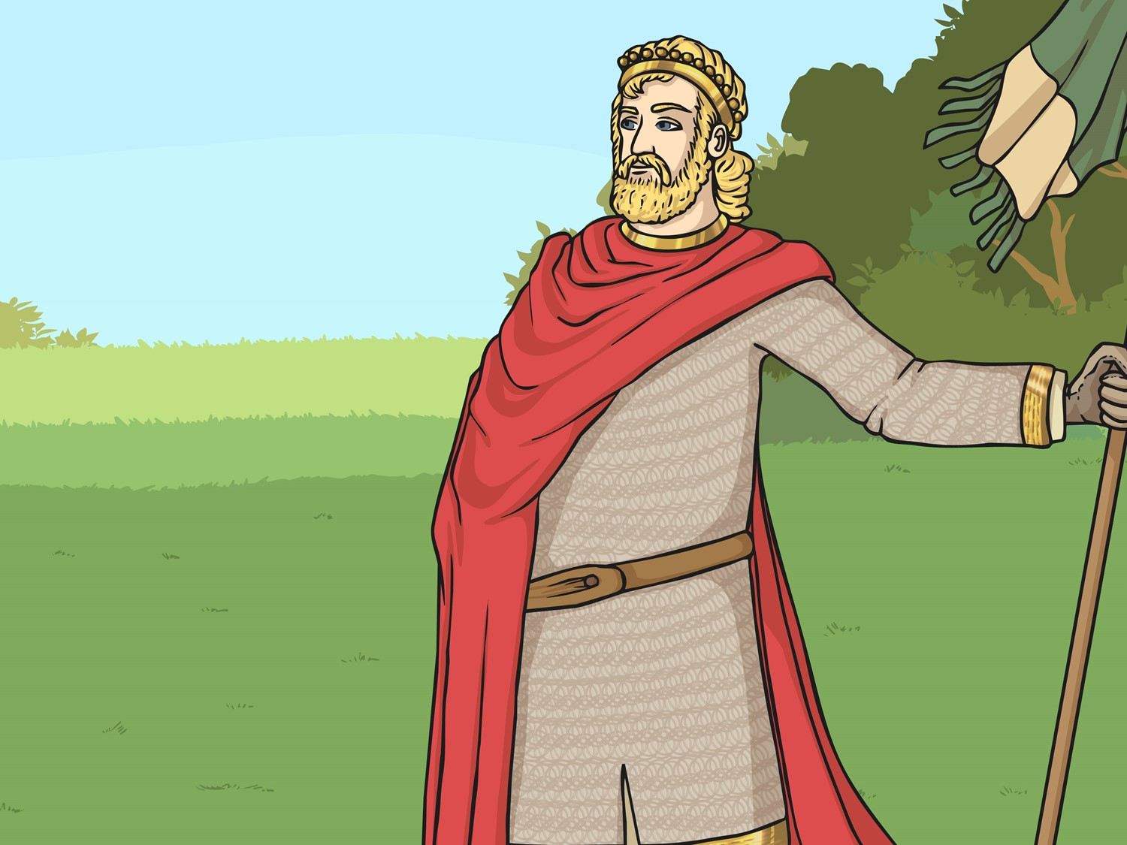
AD 1035
King Cnut dies. His sons Harold Harefoot and Hardicanute share the ruling of England. Harold dies in 1040 and Hardicanute becomes the sole ruler of England.

Slide 22
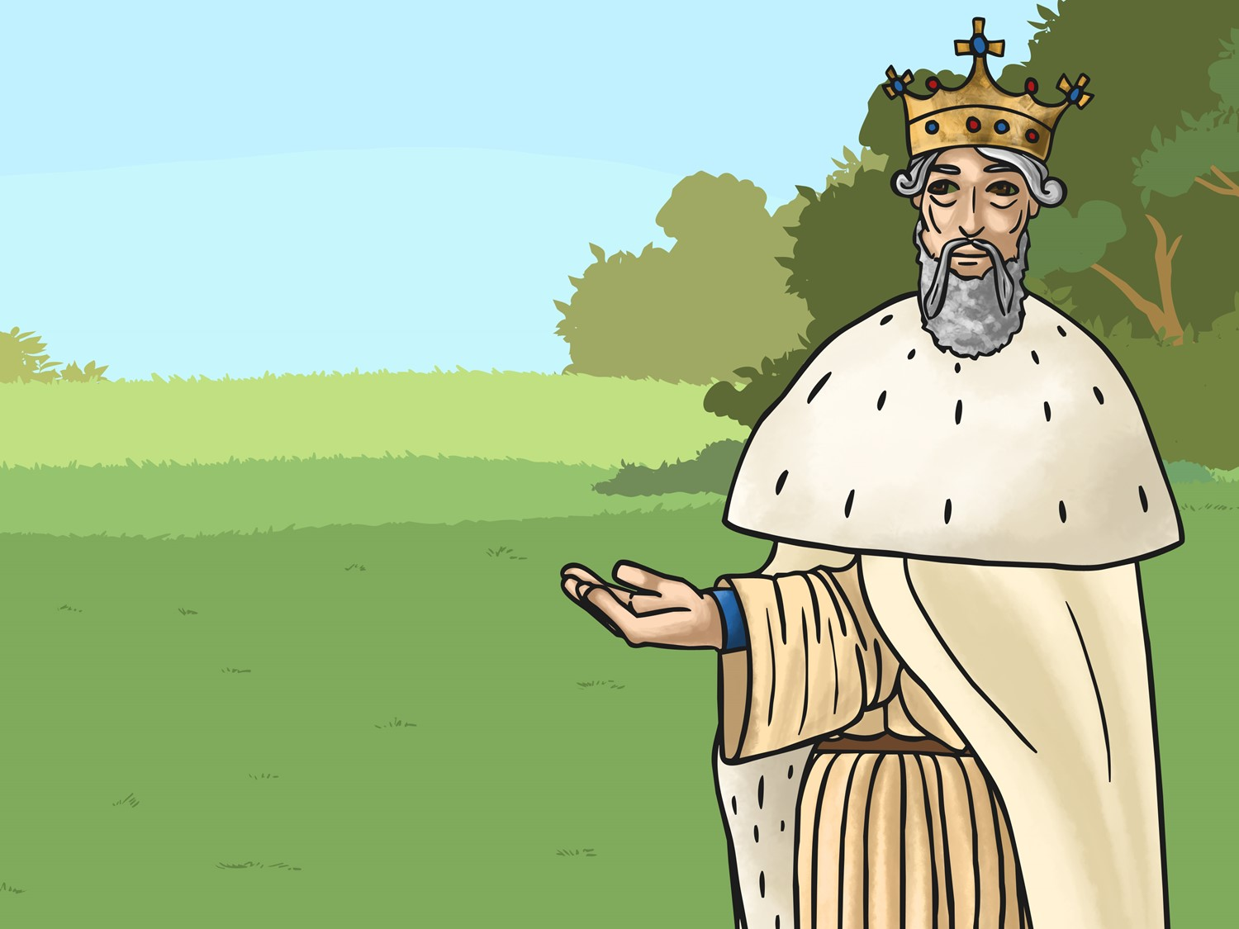
AD 1042
Ethelred’s second son, Edward is invited to return from Normandy to become the King of England. Edward was better known as ‘Edward the Confessor’ due to his extreme piety.

Slide 23
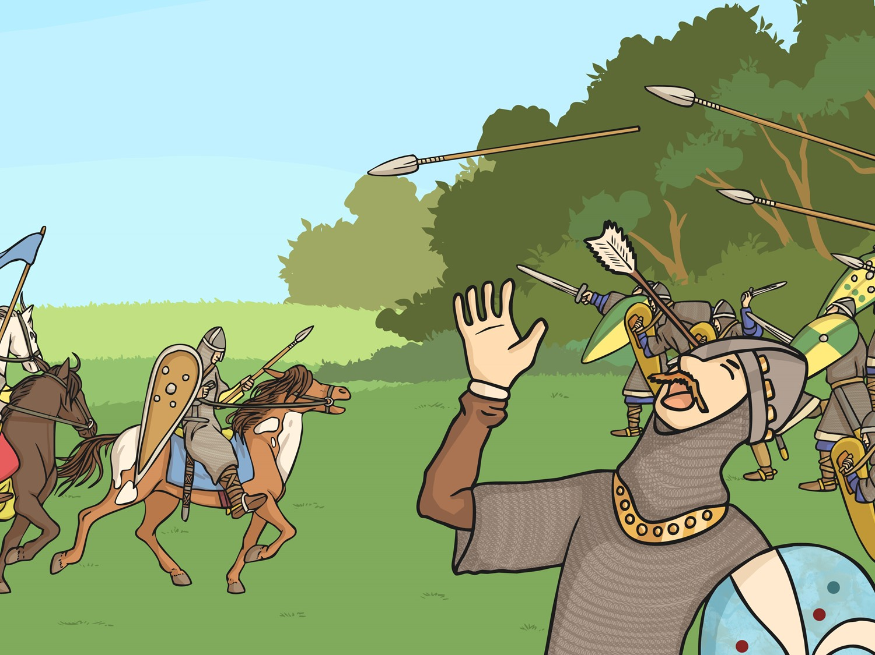
AD 1066
The last Anglo-Saxon king, King Harold, is defeated by William the Conqueror at the Battle of Hastings and Norman Britain begins.

Slide 24


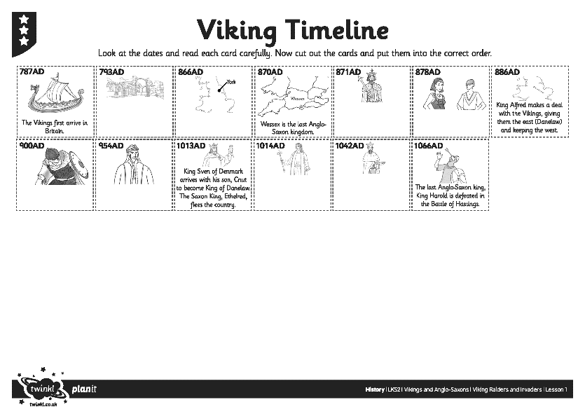
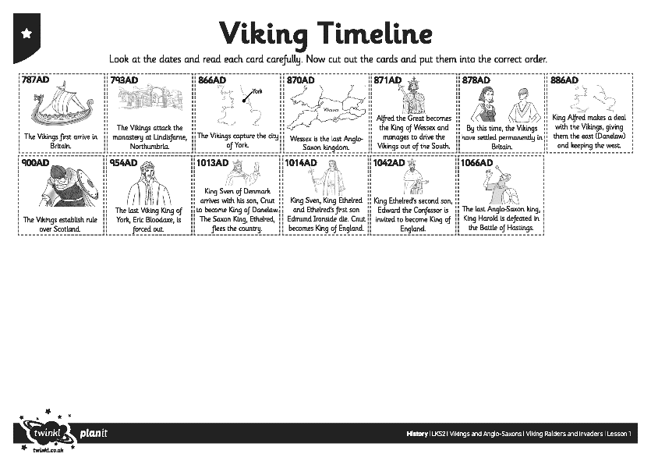
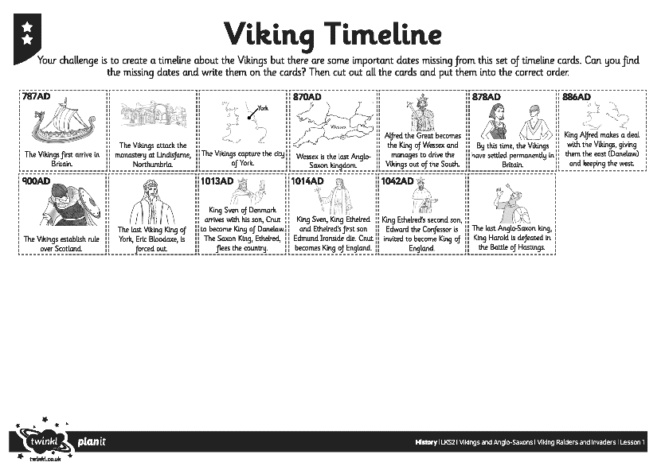
Viking Timeline Activity
Your challenge is to create your own Viking Timeline to help you remember and order the important facts about the Vikings.
Look at the Viking Timeline Posters to help you if you get stuck.

Slide 25

Vikings and Kings
Who thinks they can act in role as a Viking warrior or an Anglo-Saxon king to answer the questions the rest of your class may choose to ask you?
Questions for a
Viking Warrior
Questions for an
Anglo-Saxon King
Who are the Vikings?
Where do you come from?
When did you come to Britain and why?
Or can you think of a question of your own?
Where have these Vikings come from?
How have you and your people been affected?
What have the Vikings done?
Or can you think of a question of your own?

Slide 26

Aim
I can explain when and where the Vikings came from and say why they raided Britain.
Success Criteria
I can order events from the time of the Vikings.
I can create a poster containing details about who the Vikings were and what they did.
I can act in role to ask or answer questions.

